Slide 1

Developing the Schedule

Slide 2
Chapter Concepts
Estimating the resources required for each activity
Estimating the duration for each activity
Establishing the estimated start time and required completion time for the overall project
Calculating the earliest times at which each activity can start and finish, based on the project estimated start time
Calculating the latest times by which each activity must start and finish in order to complete the project by its required completion time
Determining the amount of positive or negative slack between the time each activity can start or finish and the time it must start or finish
Identifying the critical (longest) path of activities
Performing the steps in the project control process
Determining the effects of actual schedule performance on the project schedule
Incorporating changes into the schedule
Developing an updated project schedule
Determining approaches to controlling the project schedule
Implementing agile project management

Slide 3
Learning Outcomes
Estimate the resources required for activities
Estimate the duration for an activity
Determine the earliest start and finish times for activities
Determine the latest start and finish times for activities
Explain and determine total slack
Prepare a project schedule
Identify and explain the critical path
Discuss the project control process
Develop updated schedules based on actual progress and changes
Discuss and apply approaches to control the project schedule
Explain agile project management

Slide 4
Project Integration Management Project Time Management
Project Management Knowledge Areas from PMBOK® Guide

Slide 5
Estimate Activity Resources
Resources include
People, materials, equipment, facilities
Influence on the duration
Availability of the resources
Types of resources
Sufficient quantities of resources for the activity durations
Potential conflicts with other projects may cause
Involve person with expertise in resource estimate
Estimates influence costs

Slide 6
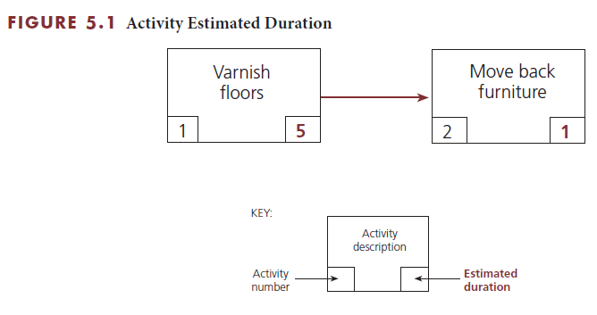
Estimate Activity Durations
Duration must be the total elapsed time
Time for the work to be done plus any associated waiting time

Slide 7
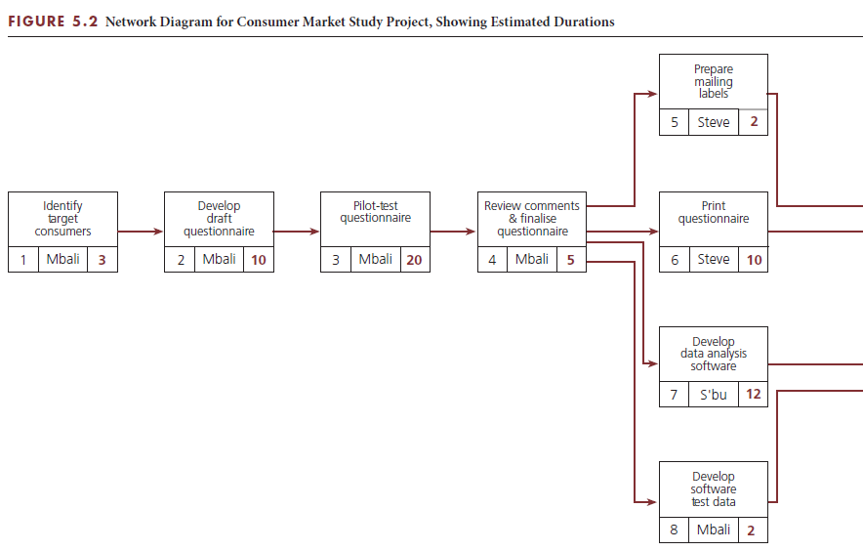
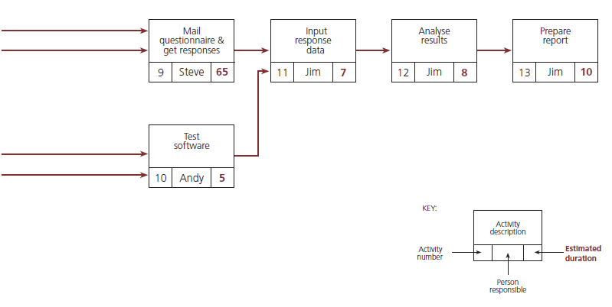
Estimate Activity Durations

Slide 8
Establish Project Start and Completion Times
Define the overall window for project completion
May not want to commit to a specific date
Project not to start until customer has approved the contract
Delay in contract signing may impact project start
Set finish time as number of days from project start

Slide 9
Develop Project Schedule
Prior activities for schedule development
Estimate duration of each activity
Establish overall window of time for the project
Develop the schedule timetable
Earliest start and finish times based on estimated start date
Latest start and finish times based on required completion date

Slide 10
Earliest start and finish times
Earliest start time (ES)
Earliest time at which a specific activity can begin
Earliest finish time (EF)
Earliest time by which a specific activity can be completed
EF = ES + Estimated duration
Calculate forward through the network diagram

Slide 11
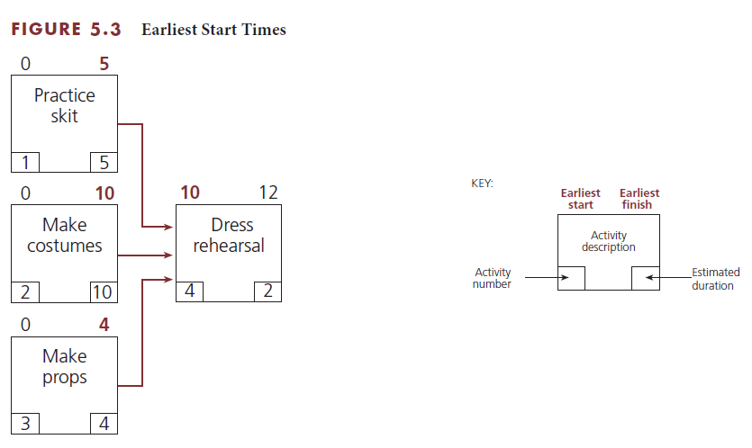
Earliest start and finish times calculation
Why is the ES for 'Dress rehearsal’ 10?

Slide 12
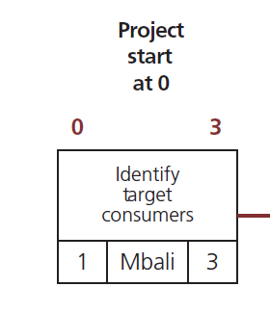
'Identify target consumers'
Start date = 0
ES = Start date = 0
Duration = 3
EF = 0 + 3 = 3

Slide 13
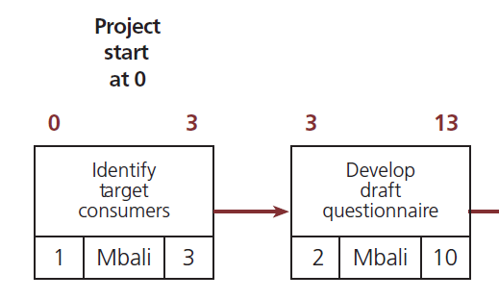
'Develop draft questionnaire'
ES = EF Task 1 = 3
Duration = 10
EF = 3 + 10 = 13

Slide 14
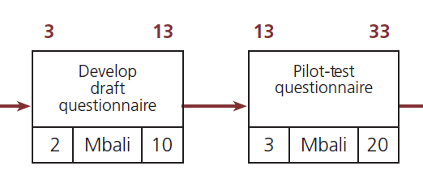
'Pilot-test questionnaire'
ES = EF Task 2 = 13
Duration = 20
EF = 13 + 20 = 33

Slide 15
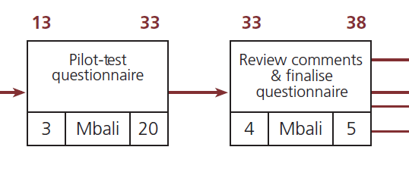
'Review comments & finalise questionnaire'
ES = EF Task 3 = 33
Duration = 5
EF = 33 + 5 = 38

Slide 16
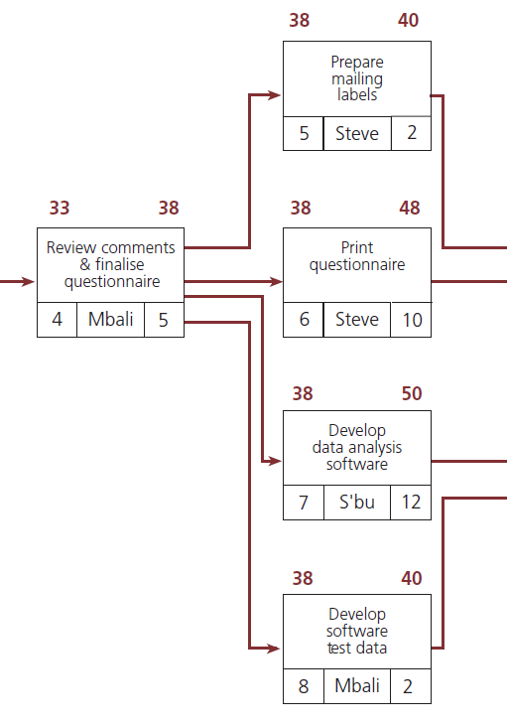
'Prepare mailing labels’, 'Print questionnaire’, 'Develop data analysis software’, and 'Develop software test data'
ES = EF Task 4 = 38
Task 5
Duration = 2
EF = 38 + 2 = 40
Task 6
Duration = 10
EF = 38 + 10 = 48
Task 7
Duration = 12
EF = 38 + 12 = 50
Task 8
Duration = 2
EF = 38 + 2 = 40

Slide 17
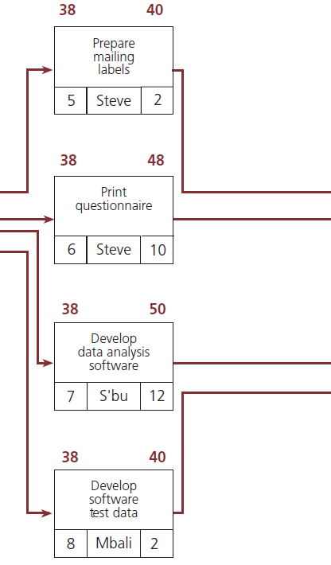
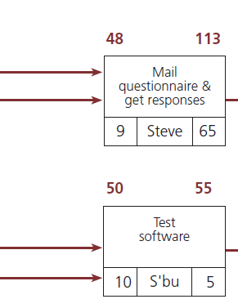
'Mail questionnaire & get responses'
Latest of Tasks 5 and 6 = 48
ES = EF Task 6 = 48
Duration = 65
EF = 48 + 65 = 113

Slide 18
'Test software'
Latest of Tasks 7 and 8 = 50
ES = EF Task 7 = 50
Duration = 5
EF = 50 + 5 = 55

Slide 19
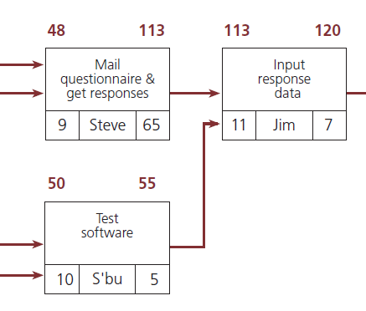
'Input response data'
Latest of Tasks 9 and 10 = 113
ES = EF Task 9 = 113
Duration = 7
EF = 113 + 7 = 120

Slide 20
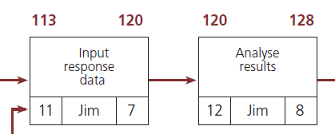
'Analyse results'
ES = EF Task 11 = 120
Duration = 8
EF = 120 + 8 = 128

Slide 21
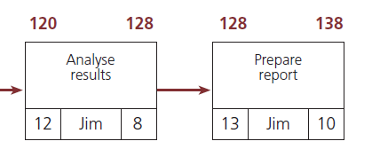
'Prepare report'
ES = EF Task 12 = 128
Duration = 10
EF = 128 + 10 = 138
Project not complete in required time

Slide 22
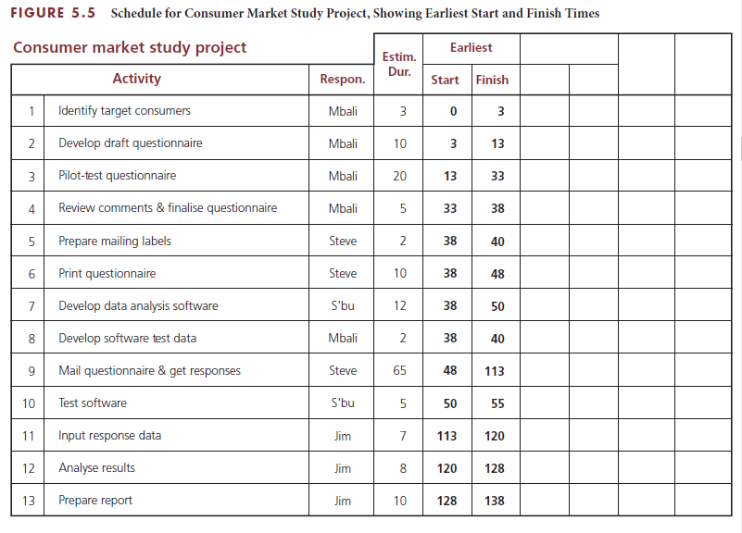
Schedule table ES and EF

Slide 23
Latest start and finish times
Latest start time (LS)
Latest time by which a specific activity must be started
Latest finish time (LF)
Latest time by which a specific activity must be completed
LS = LF – Estimated duration
Calculate backward through the network diagram

Slide 24
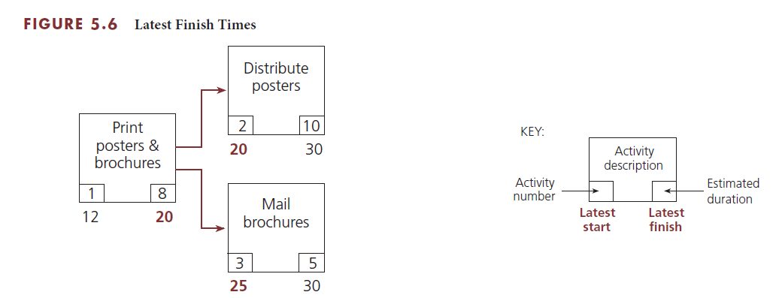
Latest start and finish times calculation
Why is the LF for 'Print posters & brochures' 20?

Slide 25
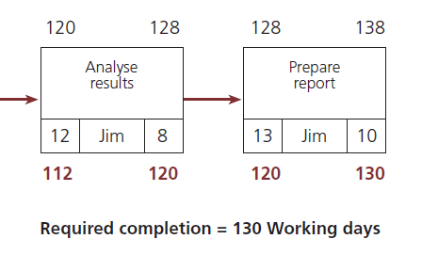
'Prepare report'
Required completion = 130
LF = Complete date = 130
Duration = 10
LS = 130 – 10 = 120

Slide 26
'Analyse results'
LF = LS Task 13 = 120
Duration = 8
LS = 120 – 8 = 112

Slide 27
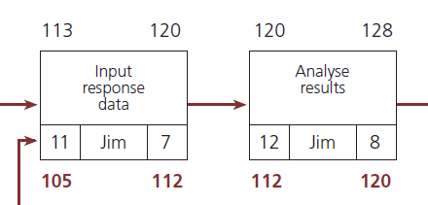
'Input response data'
LF = LS Task 12 = 112
Duration = 7
LS = 112 – 7 = 105

Slide 28
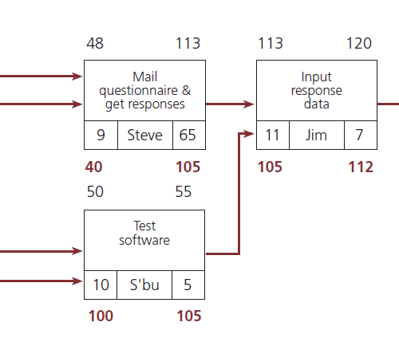
'Test software' and 'Mail questionnaire & get responses'
LF = LS Task 11 = 105
Task 9
Duration = 65
LS = 105 – 65 = 40
Task 10
Duration = 5
LS = 105 – 5 = 100

Slide 29
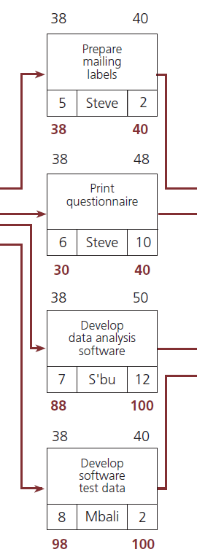
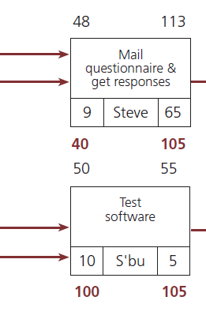
'Develop data analysis software' and 'Develop software test data'
LF = LS Task 10 = 100
Task 7
Duration = 12
LS = 100 – 12 = 88
Task 8
Duration = 2
LS = 100 – 2 = 98

Slide 30
'Prepare mailing labels' and 'Print questionnaire'
LF = LS Task 9 = 40
Task 5
Duration = 2
LS = 40 – 2 = 38
Task 6
Duration = 10
LS = 40 – 10 = 30

Slide 31
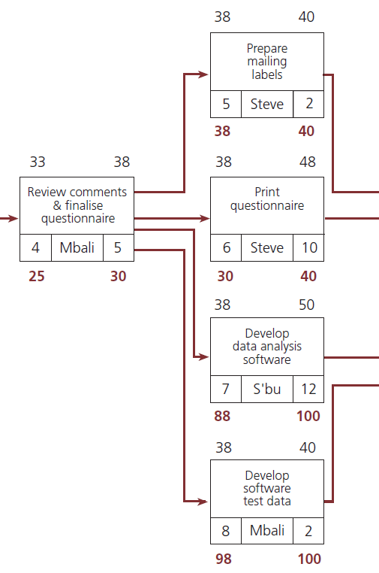
'Review comments & finalise questionnaire'
LF = Earliest LS of Tasks 5, 6, 7, and 8 = 30
LF = LS Task 6 = 30
Duration = 5
LS = 30 – 5 = 25

Slide 32
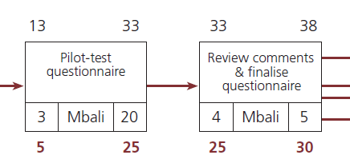
'Pilot-test questionnaire'
LF = LS Task 4 = 25
Duration = 20
LS = 25 – 20 = 5

Slide 33
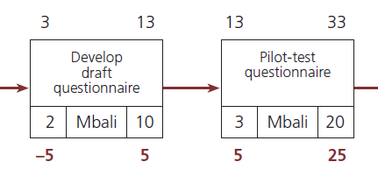
'Develop draft questionnaire'
LF = LS Task 3 = 5
Duration = 10
LS = 5 – 10 = -5

Slide 34
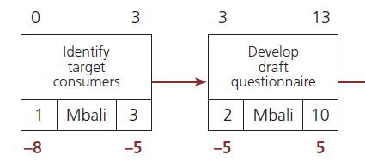
'Identify target consumers'
LF = LS Task 2 = -5
Duration = 3
LS = -5 – 3 = -8
Start date = 0
Project is 8 days late at start

Slide 35
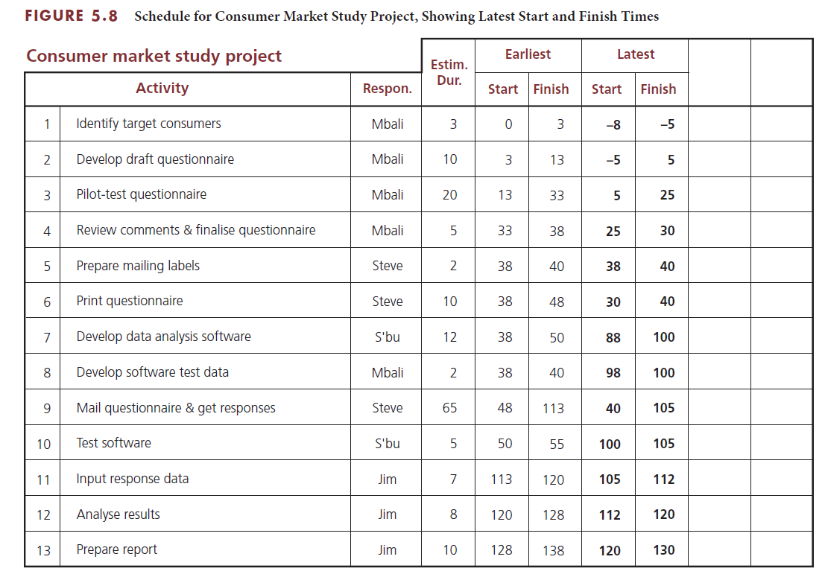
Schedule table LS and LF

Slide 36
Total slack
Sometimes called float
The difference between EF time of last activity and the project required completion time
Negative slack
Lack of slack over the entire project
Amount of time an activity must be accelerated
Positive slack
Maximum amount of time that the activities on a particular path can be delayed without jeopardising on-time completion

Slide 37
Critical path
Longest path in the overall network diagram
Find which activities have the least amount of slack

Slide 38
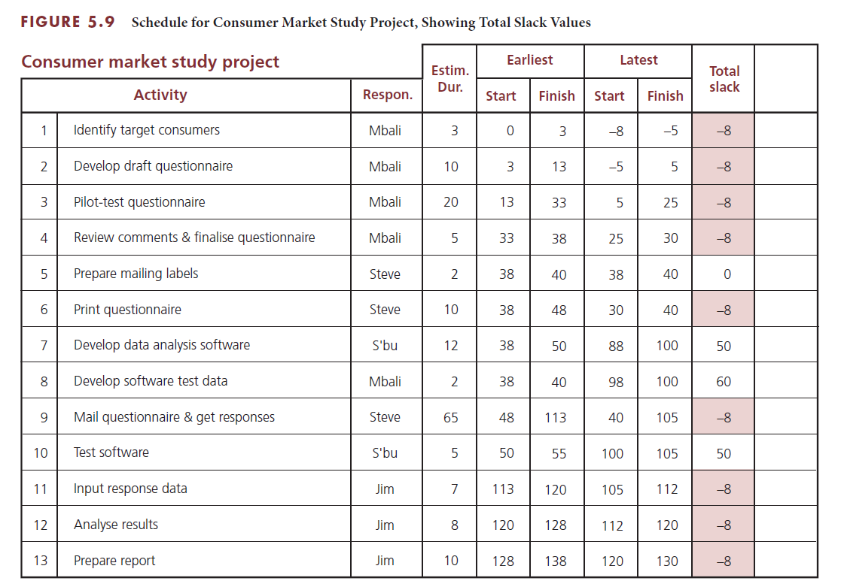
Critical path through a project

Slide 39
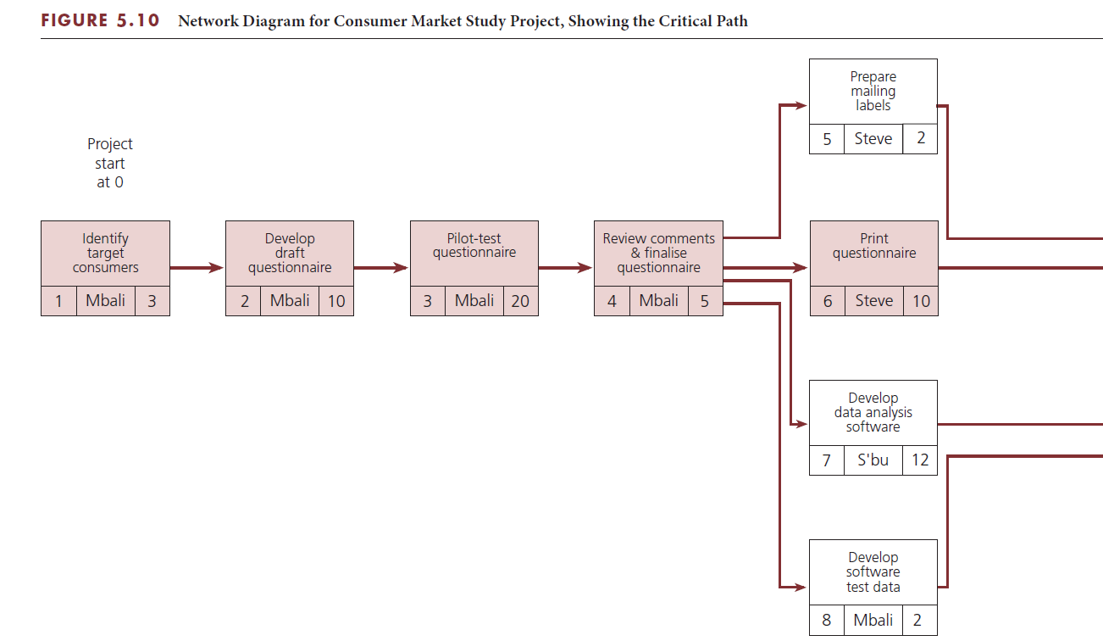
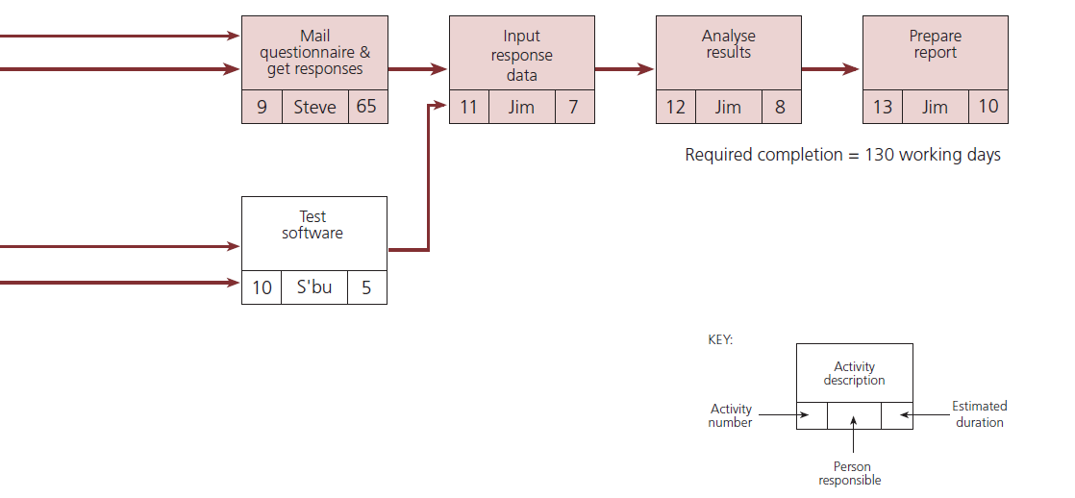
Critical path through a project

Slide 40
Critical path through a project

Slide 41
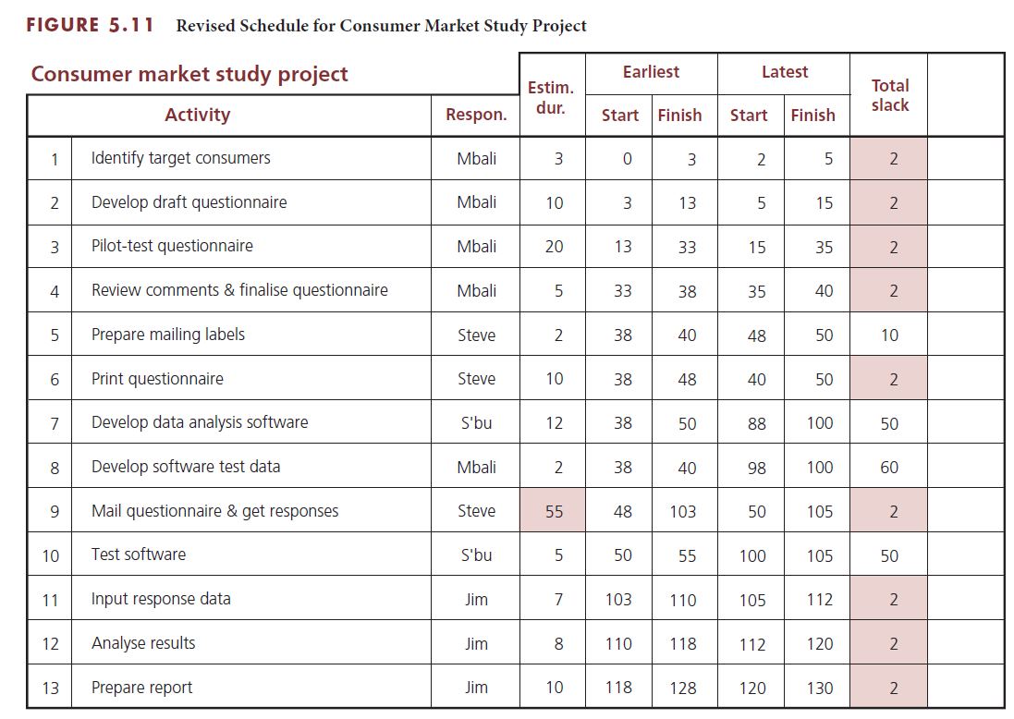
Change in slack for critical path

Slide 42
Free slack
Time a specific activity can be postponed without delaying the ES of its immediate successor activities
Calculation
Find lowest of the values of total slack for all the activities entering into a specific activity
Subtract value from the values of total slack for the other activities also entering into that same activity

Slide 43
Total slack compared to free slack
Total slack for Activity 7 = 50
Total slack for Activity 8 = 60
Free slack for Activity 8 = 60 – 50 = 10 days

Slide 44
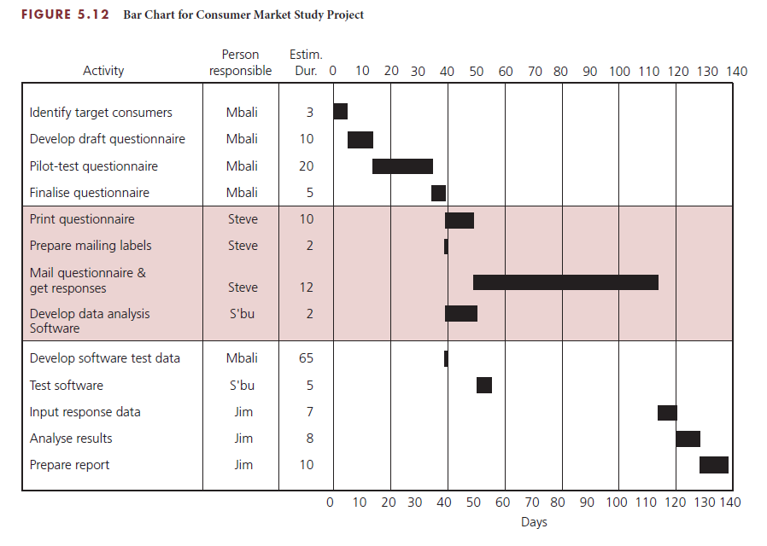
Bar chart format
Gantt chart tool for planning and scheduling
Activities on side
Time scale on top or bottom
Estimated duration in bars
Automatically generated in software systems
Can show relationships between activities

Slide 45
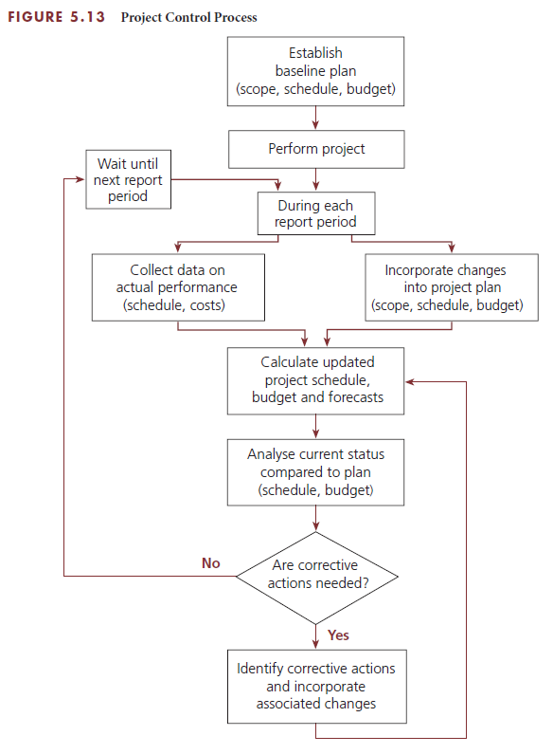
Project Control Process
Meetings occur regularly
Gather data on actual performance
Record changes
Monitor progress

Slide 46
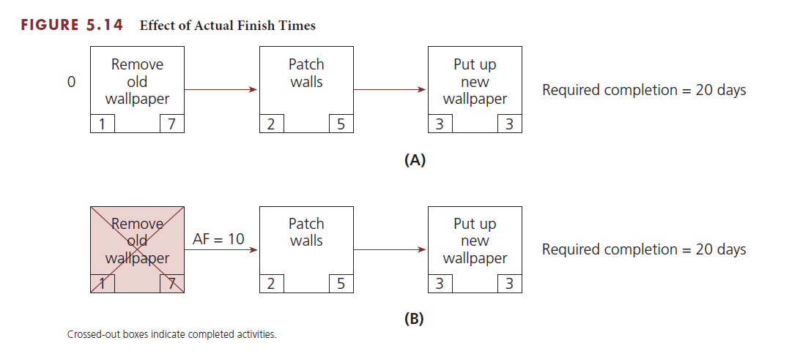
Effects of Actual Schedule Performance
Part (a) Total slack = +5
Part (b) Total slack = +2

Slide 47
Incorporate Changes into Schedule
Changes may impact the schedule
Initiated by customer or project team
Result from unanticipated occurrence
Early change may have less impact than later change
Manage requested changes
Estimate impact
Obtain customer approval
Revise project plan, schedule, and costs

Slide 48
Update Project Schedule
Generate forecasts for project finish
Use actual finish dates of completed activities
Enter project changes
Update project schedule
Determine if any changes occur in critical path

Slide 49
Control Schedule
Schedule control steps
Actions
Analyse the schedule for needed corrective action
Decide specific corrective actions to be taken
Revise the plan to incorporate corrective actions
Recalculate the schedule to evaluate the effects of the planned corrective actions
Repeat steps if not acceptable results
Apply efforts to paths with negative slack
Near-term activities
Long estimated durations
Change may shift critical path
Trade-off of costs and scope

Slide 50
Scheduling for Information Systems Development
Common problems
Failure to identify all user requirements
Failure to identify user requirements properly
Continuing growth of project scope
Underestimating learning curves for new software packages
Incompatible hardware
Logical design flaws
Poor selection of software
Failure to select the best design strategy
Data incompatibility issues
Failure to perform all phases of the SDLC

Slide 51
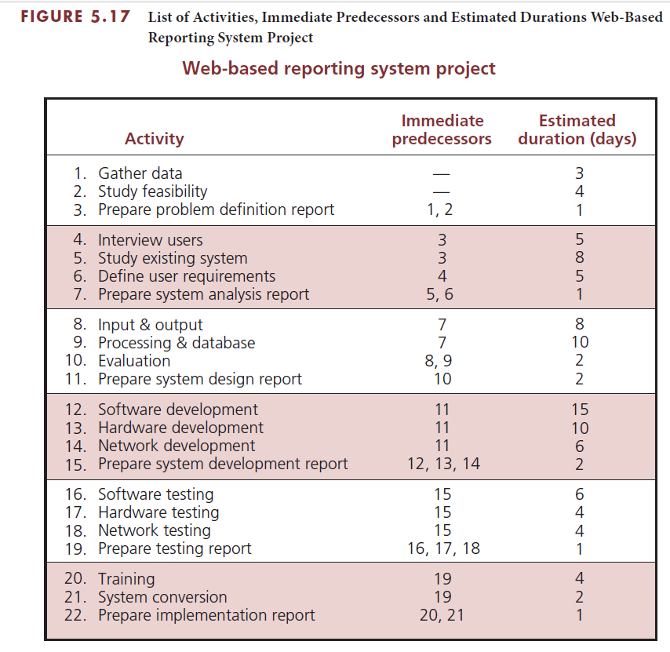
IS example: activities, predecessors, durations

Slide 52
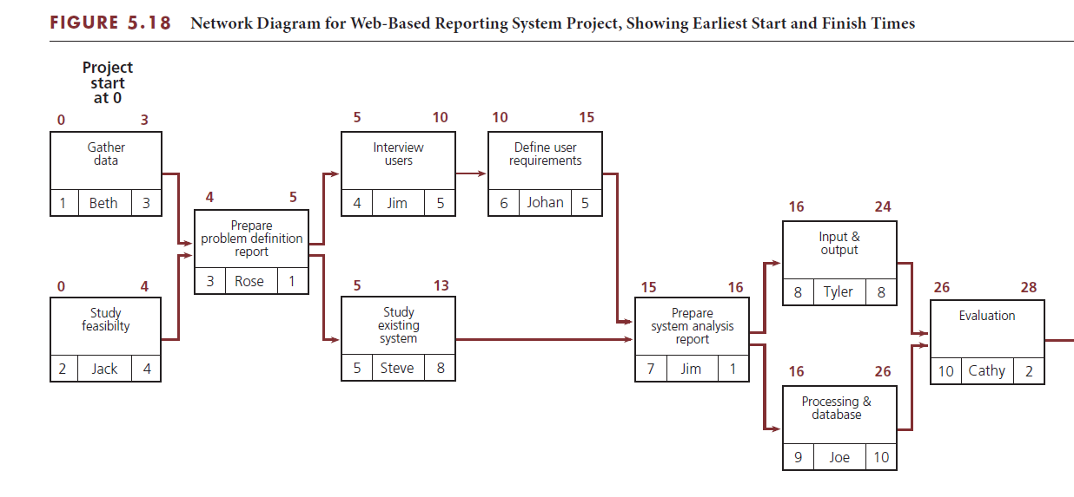
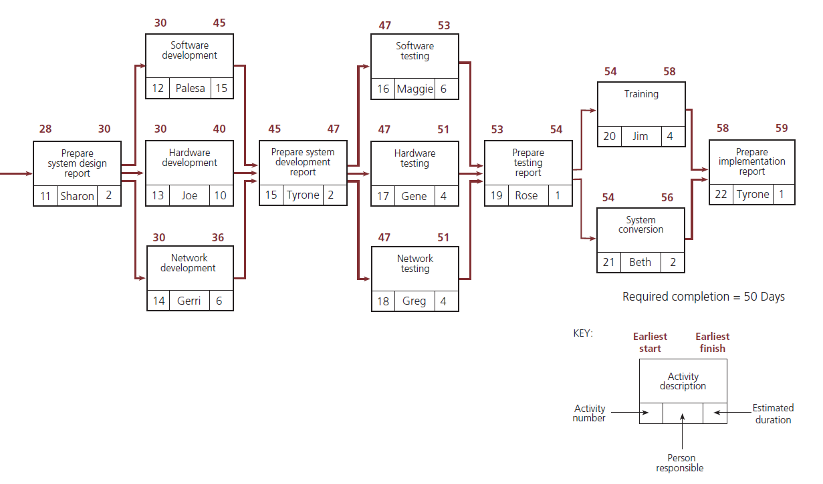
IS example: ES and EF times

Slide 53
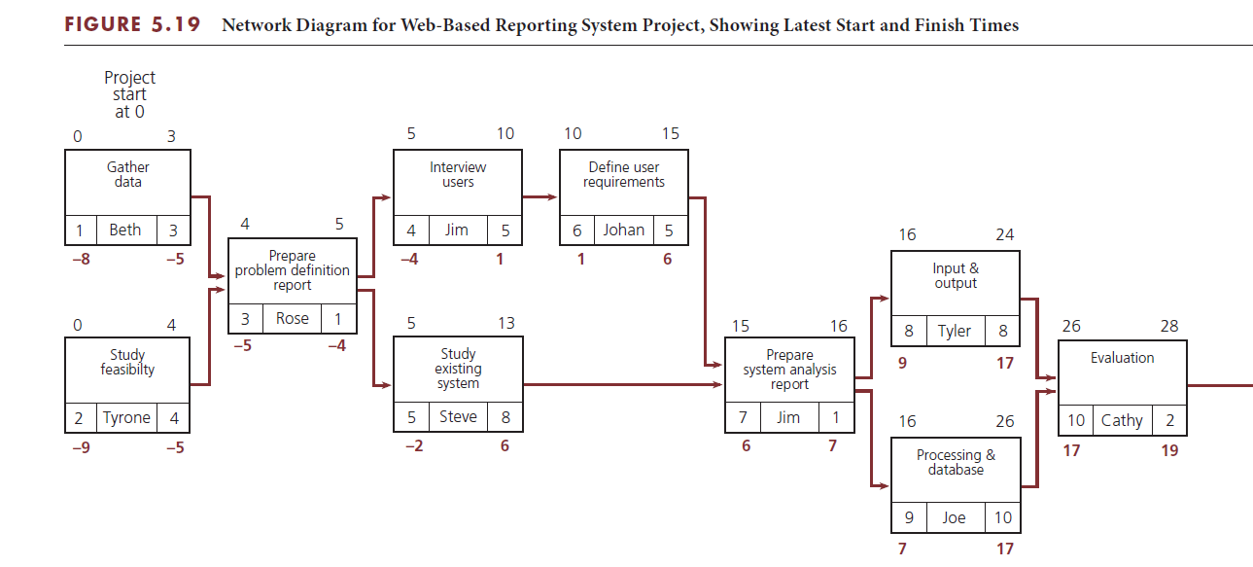
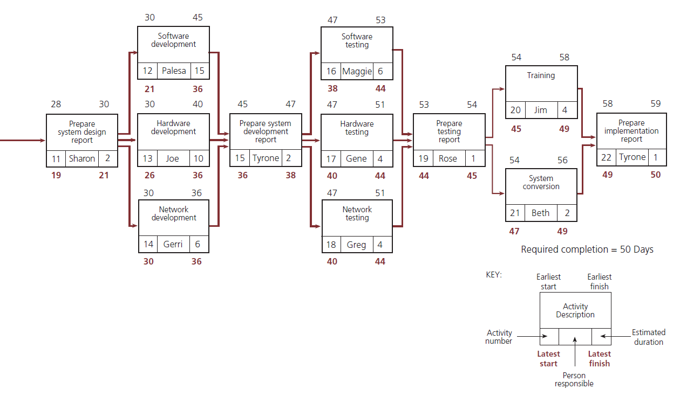
IS example: LS and LF times

Slide 54
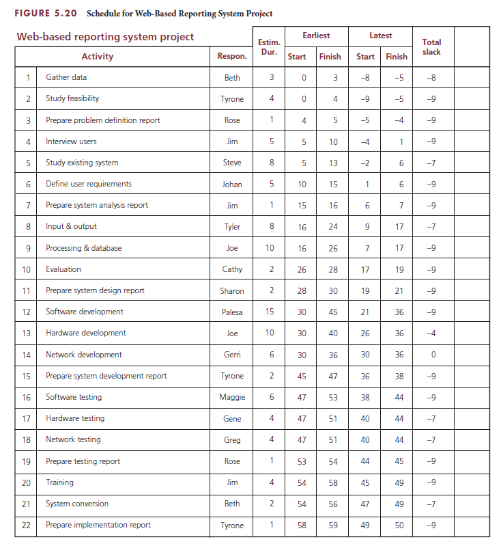
IS example: schedule table

Slide 55
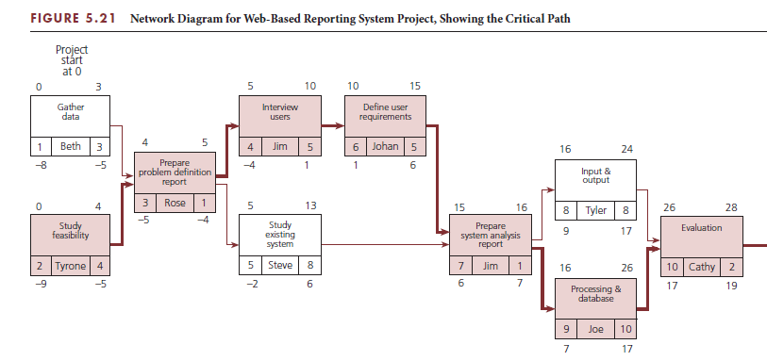
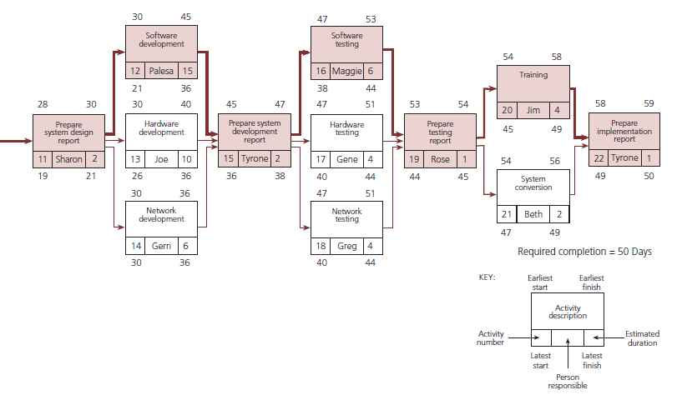
IS example: critical path

Slide 56
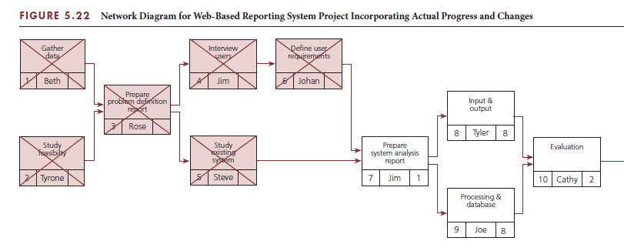
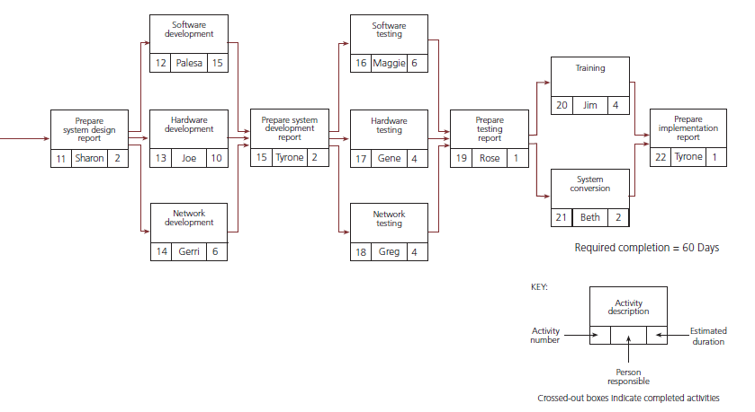
IS example: updated network diagram

Slide 57
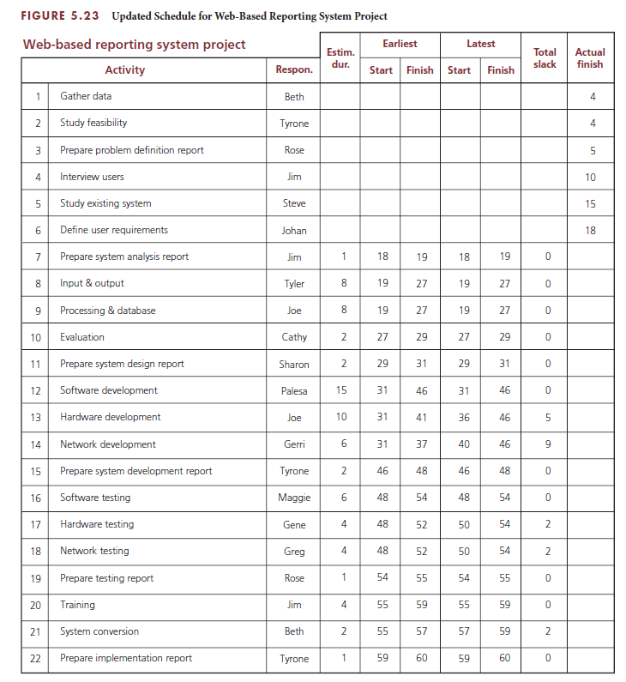
IS example: updated schedule table

Slide 58
Project Management Information Systems
Most systems perform scheduling functions
Calculates at click of the mouse
ES, EF, LS, and LF
Total slack
Critical path
Perform control functions

Slide 59
Agile Project Management
Scrum approach participants
Process includes
Product owner
Development team
Scrum master
Establish and authorise
Define requirements
Conduct daily scrum meetings
Conduct sprint review meeting
Conduct sprint retrospective meeting

Slide 60
Critical Success Factors
The person who will be responsible for performing the activity should estimate the duration for that activity. This generates commitment from the person.
The estimated duration for an activity must be based on the types and quantities of resources required to perform the activity.
Activity estimated durations should be aggressive yet realistic.
Activities should not be longer in estimated duration than the time intervals at which the actual progress will be reviewed and compared to planned progress.
Project management involves a proactive approach to controlling a project to ensure that the project objective is accomplished even when things do not go according to plan.
Once the project starts, it is important to monitor progress to ensure that everything is going according to plan.
The key to effective project control is measuring actual progress and comparing it to planned progress on a timely and regular basis and taking any needed corrective action immediately.
The key to effective schedule control is to address any paths with negative or deteriorating slack values aggressively as soon as they are identified. A concentrated effort to accelerate project progress must be applied to these paths.

Slide 61
Critical Success Factors (continued)
The amount of negative slack should determine the priority for applying these concentrated efforts.
When attempting to reduce the duration of a path of activities that has negative slack, focus on activities that are near term and on activities that have long estimated durations.
Addressing schedule problems early will minimise the negative impact on scope and budget.
If a project falls too far behind, getting it back on schedule becomes more difficult, and usually requires spending more money or reducing the scope or quality.
If corrective actions are necessary, decisions must be made regarding a trade-off of scope, time, and cost.
A regular reporting period should be established for comparing actual progress to planned progress.
The shorter the reporting period, the better the chances of identifying problems early and taking corrective actions.
During each reporting period, data on actual performance and information on changes to the project scope, schedule, and budget need to be collected in a timely manner and used to calculate an updated schedule and budget.

Slide 62
Summary
The scheduling function depends on the planning function.
The estimated types and quantities of resources required for an activity, together with the availability of those resources, will influence the estimated duration for how long it will take to perform the activity.
The estimated duration for each activity must be the total elapsed time – the time for the work to be done plus any associated waiting time.
The estimate should be aggressive yet realistic.
It may be easier to estimate the durations for near-term activities, but as the project progresses, the project team can progressively elaborate the estimated the durations as more information becomes known to allow for more accurate estimated durations.
A project schedule provides a timetable for each activity and shows the earliest start (ES) and earliest finish (EF) times and the latest start (LS) and latest finish (LF) times for each activity.
The total slack for a particular path of activities through the network is common to and shared among all activities on that path.

Slide 63
Summary (continued)
The critical path is the longest (most time-consuming) path of activities in the network diagram.
The key to effective project control is measuring actual progress and comparing it to planned progress on a timely and regular basis and taking any needed corrective action immediately.
Actual progress – whether faster or slower than planned – will have an effect on the schedule of the remaining, incomplete activities of the project.
Any type of change – whether initiated by the customer, the contractor, the project manager, a team member, or an unanticipated event – will require a modification to the plan in terms of scope, schedule, and/or budget.
Schedule control involves four steps: analysing the schedule to determine which areas may need corrective action, deciding what specific corrective actions should be taken, revising the plan to incorporate the chosen corrective actions, and recalculating the schedule to evaluate the effects of the planned corrective actions.
One of the most important factors in effective scheduling is estimating activity durations that are as realistic as possible.

